Slide 1
A1 Chemistry
covalent networks

Slide 2
1. Explain, with the aid of a diagram, how movement of electrons within an atom produces the emission spectra responsible for observations in flame tests (4 marks)
2. Describe the differences in malleability and electrical conductivity for metals and ionic compounds. Explain these properties by referring to the bonding involved (6 marks)

Slide 3
Learning intentions
the properties of covalent network substances, including high melting point, hardness and electrical conductivity, are explained by modelling covalent networks as three-dimensional structures that comprise covalently bonded atoms
elemental carbon exists as a range of allotropes, including graphite, diamond and fullerenes, with significantly different structures and physical properties

Slide 4
Success criteria
List the properties of covalent networks
Explain the properties of covalent networks by relating to the bonding arrangement
Draw or describe common carbon allotropes, such as diamond, graphite and fullerines

Slide 5
Key words
network
allotrope

Slide 6
Covalent bonding
sharing of valence electrons in order to achieve full outer shells
occurs between atoms of high electronegativity (ie non-metals)
is very strong

Slide 7
covalent networks
commonly consist of group 4 elements, such as carbon
also can occur in compounds such as silicon dioxide
unlimited number of atoms, each joined to several others by strong covalent bonds to form two or three dimensional networks or lattices

Slide 8
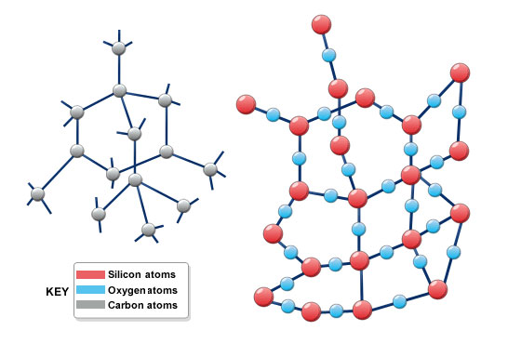

Slide 9
properties of covalent networks
Chemically inert and insoluble
Very high melting and boiling point due to strong covalent bonds between all atoms in the network lattice
Three dimensional lattices are very hard, non conductors
Two dimensional lattices tend to be softer or slippery and good electrical conductors

Slide 10
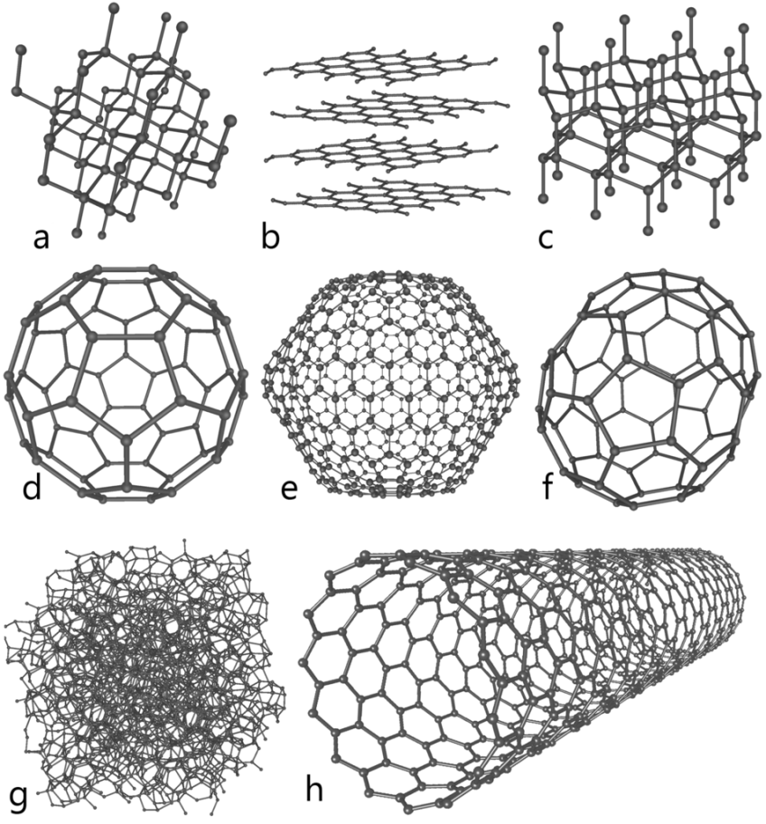
allotropes
same element, different arrangement of covalently bonded atoms

Slide 11
carbon allotropes
Many allotropes of carbon:
diamond
graphite
amorphous (“activated”) carbon
fullerenes (“buckyballs”)
nanotubes

Slide 12
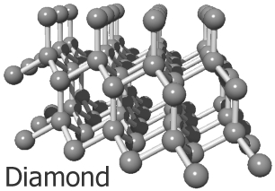
diamond
each carbon is covalently bonded to 4 other carbons
all electrons are tightly bonded

Slide 13
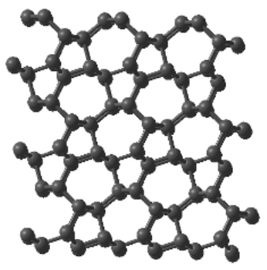
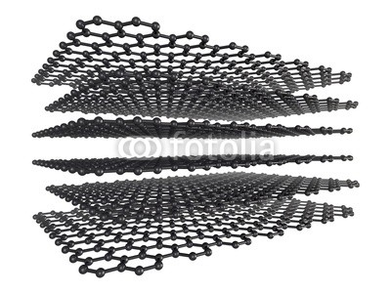
graphite
each carbon is covalently bonded to 3 other carbons, leaving one electron delocalised, in a sheet-like structure

Slide 14
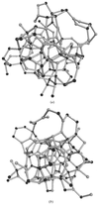
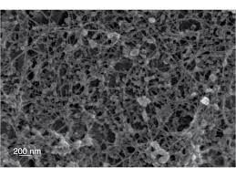
amorphous
small particles, each similar to pieces of graphite although less regular

Slide 15
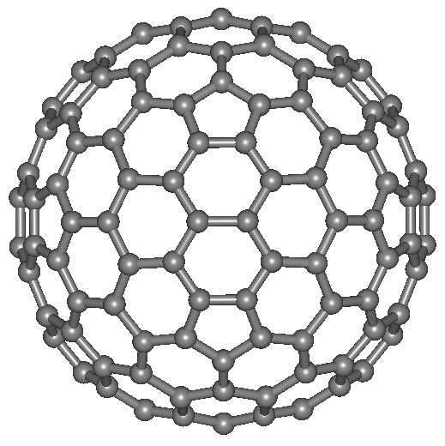
fullerenes
each carbon is bonded to 3 others, leaving one electron delocalised, in a cage-like structure

Slide 16
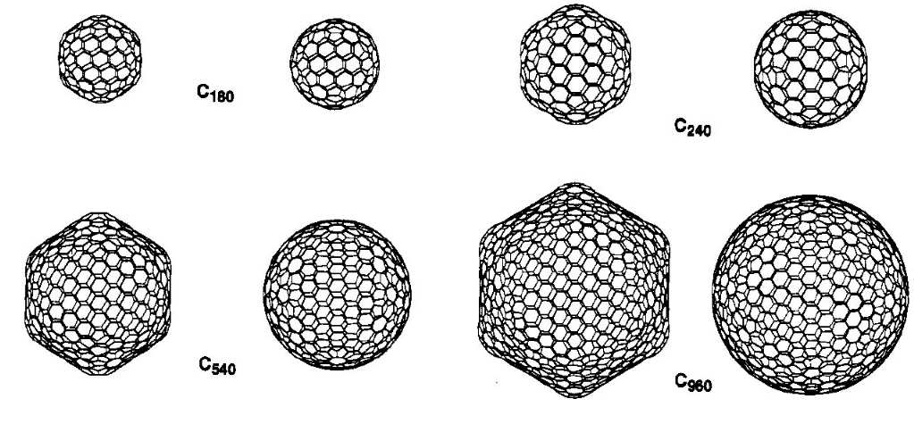

Slide 17
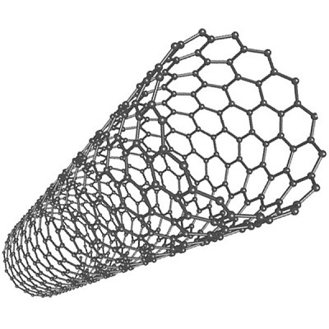
nanotubes
each carbon bonded to three others, leaving one electron delocalised, in a tube

Slide 18
Next time
Writing formulae
Electron dot diagrams

Slide 19
Do now…
Question set 3.6

